Slide 1
Writing
Preparing for the Good Mythical Morning writing test

Slide 2
In general
To make a complete text, you will need:
1 Introduction/introductory paragraph
Body: multiple paragraphs (usually 3)
1 Closing/final paragraph

Slide 3
Paragraphs
A paragraph usually explains the concept of one basic idea, or a few ideas that concern the same topic. One paragraph is one part of the subject you will discuss.
You start a new paragraph when:
You start talking about a new idea/point/part of the subject
To contrast main points/ideas/part of the subject to show a different side
When you readers need a pause (only in very long texts)
The introduction and conclusion should always be in a separate paragraph

Slide 4
IMPORTANT Make sure that…
You assume your reader has no previous knowledge about the subject, explain in detail!
Don’t assume the reader knows what goes on in your head: he or she doesn’t.
Don’t just write, read afterwards and check yourself!
The reader can actually understand what you are saying by adding logical bridges (one idea/subject throughout) and verbal bridges (linking words)

Slide 5
Linking words
Use linking words to link paragraphs together and make the structure logical.
Examples of linking can be found on this website:
https://www.dlsweb.rmit.edu.au/lsu/content/4_writingskills/writing_tuts/linking_LL/linking3.html

Slide 6
Assignment
Choose a (random) subject (it should be GMM-worthy)
Research and find information
Collect information on one piece of A4 paper (you can bring this to the test)
Write a competition entry (HAVO) OR
Write an article (HAVO/VWO)

Slide 7
Competition entry
There is a competition for GMM-fans in which you can win/get featured on a new episode of Good Mythical Morning.
You enter by writing a competition entry to a panel of judges (the GMM-crew), giving information about your topic/subject and explain why this topic/subject should be on GMM.

Slide 8
Article
You are part of the GMM-crew and you’re doing research for a new episode. The information you find will be used and has to be detailed and complete.

Slide 9
Competition entry includes:
Title (optional)
Introductory paragraph: contains a good (catchy) opening sentence, explains reason for entry
Body (Kern): development with lots of details
Final paragraph: contains a strong closing sentence.
General: written for a judge or panel of judges. Includes some persuasion and gives reason(s) why the candidate’s choice is best.

Slide 10
Article includes:
Title: should be interesting, e.g. in the form of a question
Introductory paragraph: states the subject
Body: development with lots of details
Closing paragraph: expresses an opinion
General: the reader has similar interests to the writer. Main purpose is to interest and engage the reader, so there should be some opinion or comment. A description or anecdote may be included. It is factual and informal.

Slide 11
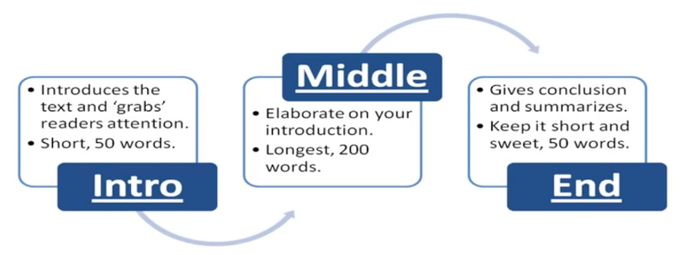
Article guideline example

Slide 12
Good luck!
Bring the information you gathered to the test
Make sure it has been checked by your expert

